Slide 1

How to implement a Document Management Center for corporate users?
Jean-Marc Herr
General Manager
I.R.I.S Solutions & Experts

Slide 2
Why Corporate Information Governance
Corporate Information Governance
Support for Cost Controlling
Require and Reinforce Methodologies
Meet International rules like Mifid, Sorbam,

Slide 3
Information management history
Archive paper documents
Increase employee productivity
Manage living documents
Solution for Legal Archiving
Fulfill Rules requirements
M²
#People
€

Slide 4
Corporate Information Governance
You can't afford not to manage
your Corporate information
Corporate information
is Business Critical

Slide 5
Methodology

Slide 6
Methodology
Some Remarks from our experience

Slide 7
Enterprise Content Management (ECM)
Project Type
  Scanning/OCR project = Quantitative
  ECM project = Qualitative
Project evaluation
  Scanning/OCR = #pages/%recognition
  ECM = User satisfaction
ECM Projects are more
Human projects than technical projects

Slide 8
ECM Project Risks
Solution Design
  Product
  Architecture
Performance problems at Go-live
  Tuning of Infrastructure
  Integration of existing architecture
Human Management
  Change Management
  User training
  Work organization

Slide 9
Strong specialist teams
PM Team
  Specialists
  Appropriate communication level
Information Management Team
  Document specialist
  Ontology
  Solution statement definition
Knowledge & Change Management Team
  Organizational aspects
  Vertical company Improvement

Slide 10
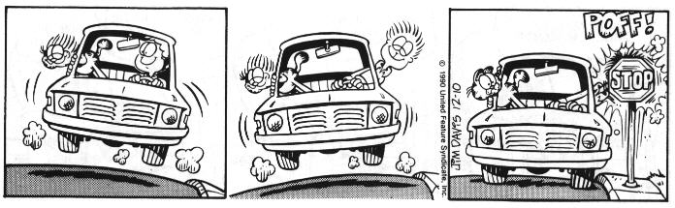
What suits one client might not suit the next

Slide 11
Methodology
Corporate leveraging

Slide 12
Corporate Information Governance
Accounting
Front Office
Back Office
Legal
ERP GUI
ERP LINK
CM for ERP
ECM Server
ERP
Coporate DataModels
MainFrame
Data
Front Office
Accounting
Back Office
Legal

Slide 13
Corporate Information Governance
PORTAIL DOCUMENTAIRE
INTRANET/EXTRANET
Accounting
Front Office
Back Office
Legal
ERP GUI
ERP LINK
CM for ERP
ECM Server
ERP
Coporate DataModels
MainFrame
Data
Front Office
Accounting
Back Office
Legal
LEGAL ARCHIVING

Slide 14
First conclusions
It’s a Corporate approach
It needs to be a Corporate approach
It should go fast
It’s Human sensitive
It’s cross department, cross business processes

Slide 15
How to implement
Corporate Information Governance
Business
DEP 1
Business PM
Business needs
Integrator
IT PM
IT requirements
IT
ECM
DEP1

Slide 16
How to implement
Corporate Information Governance
Business
DEP 1
Business PM
System is running
Business works with it
IT maintains the ECM application
IT PM
IT
ECM
DEP1

Slide 17
How to implement
Corporate Information Governance
Business
DEP 1
DEP 2
Business PM
Business needs
Integrator
IT PM
IT requirements
IT
ECM
DEP1+DEP2

Slide 18
How to implement
Corporate Information Governance
Business
DEP 1
DEP 2
Business PM
What’s the experience level of Business and IT PM ?
Who takes care of the previous implementation ?
Who assures cross DEP folders or queries ?
Who assures document classifications
is not only Business Dependant ?
IT PM
IT
ECM
DEP1+DEP2

Slide 19
How to implement
Corporate Information Governance
Business
DEP 1
DEP 2
Specialists with global overview => Corporate Approach
Classification methodology=> Cross DEP
Global Coherence of indexation => Cross DEP
Pro activity => Speed & ROI tracking
Corporate Culture know-how => Human Factor Mgnt
Impose an implementation methodology => Speed
Information
Management
IT
Specialists with global understanding
FTE forecasting
Sustain of activities
Protection thanks to implementation methodology
Business conflicts and misunderstanding avoided
Clear and defined SLA !
ECM

Slide 20
Last conclusions
Volume is requiered:
  Helps to maintain intern specialists
  Improves speed of each project
  Helps to negociate licence prices
  Helps to build a cross departments search engine
  Helps in the legal archiving architecture definition
  Helps to get the added value back of a corporate approach

Slide 21
Last conclusions
Need of a proactive team who « Sales » intern projects
Need to be sustained by CEO directives or intern policies,
Request dedicated and specialized people
If you don’t have the speed and the project volume go to outsourcing with specialists like IRIS !

Slide 22
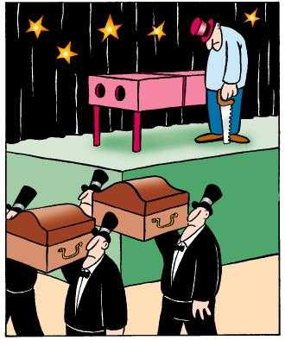
Not every presentation is successful

